Slide 1

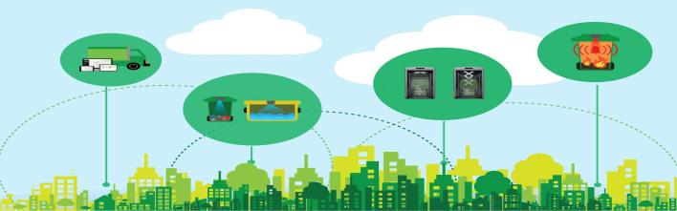

B.Tech External Evaluation, VIIIth Sem Automatic Clean Out Corner
project PRESENTED by-
Under the Supervision of:-
Mr. Sudeep Varshney
Assistant Professor,
Sharda University, Gr. Noida
Aditi Chandra, 2018002388
Aniket Kulshreshtha, 2018008832
NIKIT BANSAL, 2018005038
SHIVAM SHARMA, 2018004547
Jitin kumar singh, 2018015527
DEPARTMENT OF COMPUTER SCIENCE & ENGINEERING SCHOOL OF ENGINEERING AND TECHNOLOGY
MAY, 2022

Slide 2
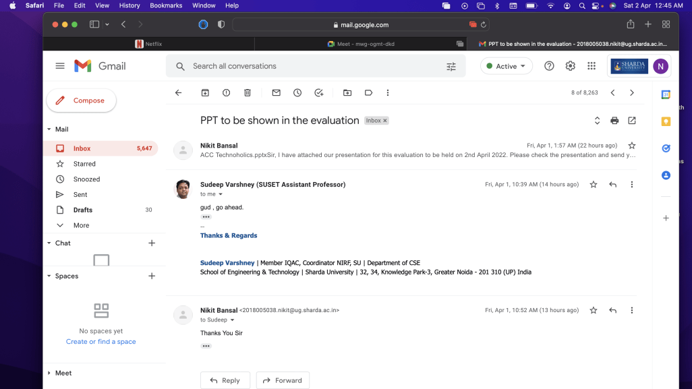
APPROVAL OF THE GUIDE

Slide 3
THE WORKFLOW OF OUR PROJECT
7th SEMESTER
Automatic opening and closing of lid
Check whether dustbin is full or not
Website for authorities created
Authentication and dashboard of the website created
Participated in IEEE YESIST 12 Hackathon
8th SEMESTER
Alert signals to authorities for immediate empty of bins and participation in the Hackathon.
GPRS tracking system
Dry and Wet waste segregation
Routing for trucks collecting waste , 2nd prize in Technovation Hackathon.

Slide 4
WORKLOAD DISTRIBUTION
ADITI CHANDRA | NIKIT BANSAL | ANIKET KULSHRESHTHA | SHIVAM SHARMA | JITIN KUMAR SINGH
HARDWARE ARDUINO/SENSOR | HARDWARE ARDUINO/SENSOR | HARDWARE ARDUINO/SENSOR | SOFTWARE BACKEND (GSM/MERN) | SOFTWARE (DB, BLINK UI)

Slide 5
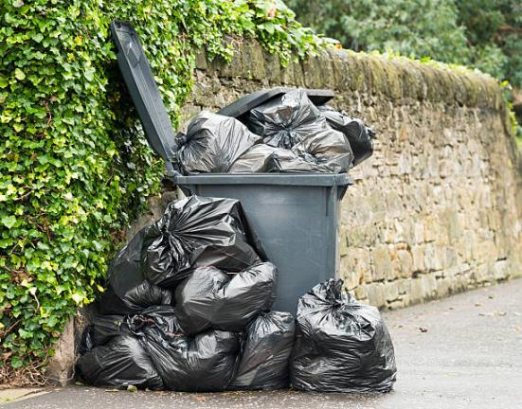

Introduction (Overview)
Managing our waste in a smarter manner is hugely important to the quality of our daily lives. Automatic Clean-out Corner can contribute to improving inefficient waste management.
Automatic Clean-out Corner is an IOT based solution to garbage collection.
Automatic Clean-out Corner help to create a cleaner, safer, more hygienic environment and enhanced operational efficiency while reducing management costs, resources, and road-side emissions.

Slide 6
Introduction (Overview)
The Automatic Clean-out Corner is ideal for busy locations such as campuses, theme parks, airports, railway stations, and shopping malls.
Automatic Clean-out Corner will ensure the cleanliness and greenish in the environment.

Slide 7


Problem Statement
There are millions of public dustbin out there that people use and are emptied in a few days by the public authorities. Now the problem is not all dustbins are filled at the same rate and the dump vehicle waste time checking each and every dustbin. This leads to more fuel usage, labour and cost. The solution is a smart dustbin.

Slide 8
LITERATURE REVIEW
ADVANTAGES | DISADVANTAGES | RESEARCH WORK
Real time information on the fill level of the dustbin. | Time consuming and less effective: trucks go and empty containers whether they are full or not. | https://arxiv.org/ftp/arxiv/papers/1904/1904.13034.pdf
Cost Reduction and resource optimization. | High costs. | https://arxiv.org/ftp/arxiv/papers/1908/1908.05849.pdf
Improves Environment quality -Fewer smells - Cleaner cities | Unhygienic Environment and look of the city. | https://www.technoarete.org/common_abstract/pdf/IJSEM/v7/i1/Ext_03468.pdf
Intelligent management of the services in the city. | Bad smell spreads and may cause illness to human beings. | https://techxplore.com/news/2019-08-automatically-garbage.html
Effective usage of dustbins. | More traffic and Noise. | https://www.golectures.com/index.php?go=search&yti=G7XjSHoNDQ8
Deployment of dustbin based on the actual needs. | Dustbin locations are not pre-planned. | https://www.ijert.org/research/smart-trash-collecting-and-segregating-robot-IJERTV9IS110152.pdf

Slide 9
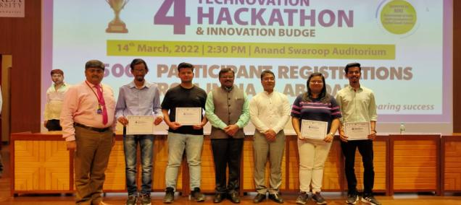
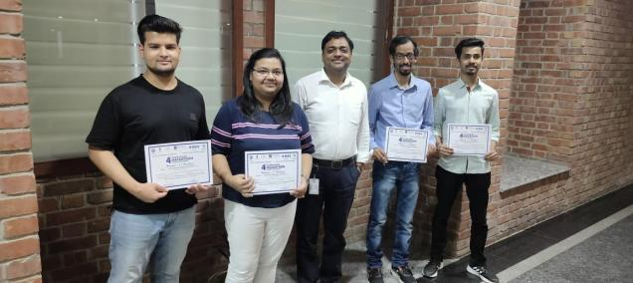
PROOF OF TECHNOVATION HACKATHON

Slide 10
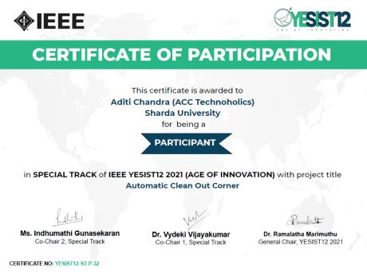
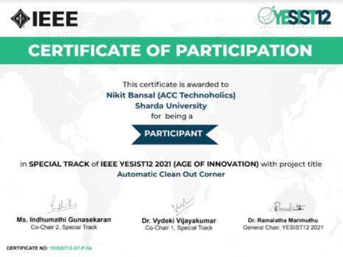
CERTIFICATES FROM IEEE YESIST12

Slide 11
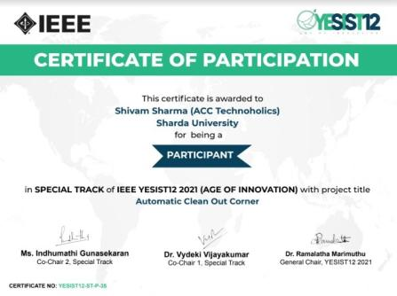
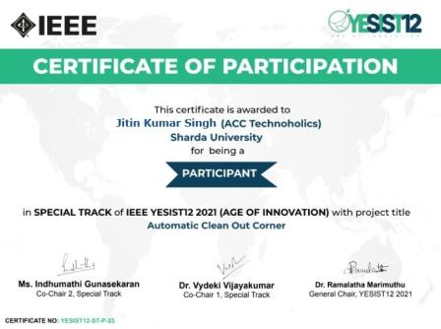
CERTIFICATES FROM IEEE YESIST12

Slide 12
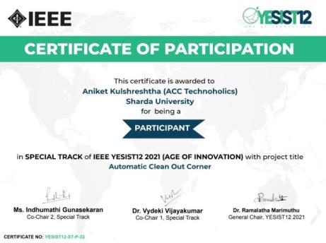
CERTIFICATES FROM IEEE YESIST12

Slide 13
MOTIVATION
Today’s world is an automated world.
Despite placing blue and green dustbins, we frequently watch that people are throwing dry waste in a wet dustbin and wet waste in a dry dustbin.
Iot is a breakthrough technology helping to make a world better and less polluted world to live in.

Slide 14


How Automatic Clean-out Corner will help?
Enabling collection of garbage generation data.
The waste segregation will be done with the help waste segregation arm and various sensors.
The waste level over the smart bin will be collected by sensors.
Once the high level of waste is detected, system will alert the authorities through GSM modules for immediate response.
An application will be developed for desired information.

Slide 15

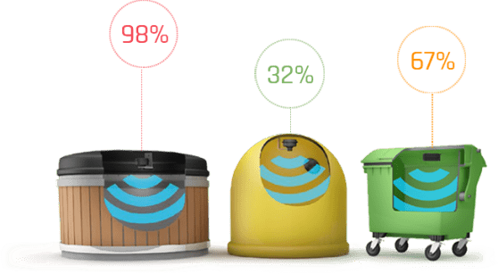
Features of Automatic Clean-out Corner
Ultrasonic Level Sensors
The smart Ultrasonic Level Sensors embedded inside the smart bin detects the fill-level of bins and send data to the cloud-based monitoring and data analytics platform. Real time monitoring of waste level with the aid of sensors and wireless communication capabilities.

Slide 16


Features of Automatic Clean-out Corner
Zero Touch Functionality
The Automatic Clean-out Corner is embedded with Infrared Sensors. Once someone tries to throw the garbage, it will detect it and open and closed the led of the bin without any physical touch.

Slide 17
Features of Automatic Clean-out Corner
Waste Segregation Arm
The Segregation arm is designed in such a way that it will take the waste from the person and also segregate the waste as dry and wet waste. It will ensure the zero touch Zero Touch policy and also the type of waste.

Slide 18
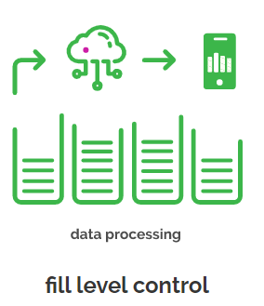
Features of Automatic Clean-out Corner
Fill Level Control
The communication module (allows notifications to be sent when the bin is ready to by emptied, or if there are any issues). They consist of IoT enabled sensors, which work as real-time indicators to determine if the bins are full or not, and help to customize the waste collection schedule accordingly.

Slide 19
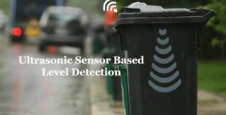
Features of Automatic Clean-out Corner
Display Monitor
The Displays Monitor displays fill level of the dustbin, the Red light indicates that the dustbin is full and the user can’t use the dustbin until is being emptied by the authorities.

Slide 20

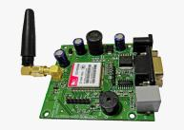
Hardware’s Required
Arduino Board
Arduino is a software company, project, and user community that designs and manufactures computer open-source hardware, open-source software, and microcontroller-based kits for building digital devices and interactive objects that can sense and control physical devices
GSM Module
A GSM modem or GSM module is a hardware device that uses GSM mobile telephone technology to provide a data link to a remote network. From the view of the mobile phone network, they are essentially identical to an ordinary mobile phone, including the need for a SIM to identify themselves to the network.

Slide 21
Hardware’s Required
NEO GPS 6M
The NEO-6M GPS module is a well-performing complete GPS receiver with a built-in 25 x 25 x 4mm ceramic antenna, which provides a strong satellite search capability. With the power and signal indicators, you can monitor the status of the module.
Servo Motor
A servomotor is a linear actuator or rotary actuator that allows for precise control of linear or angular position, acceleration, and velocity. It consists of a motor coupled to a sensor for position feedback.

Slide 22
Hardware’s Required
Wifi Module
The Arduino Uno WiFi is an Arduino Uno with an integrated WiFi module. The board is based on the ATmega328P with an ESP8266WiFi Module integrated. The ESP8266WiFi Module is a self contained SoC with integrated TCP/IP protocol stack that can give access to your WiFi network (or the device can act as an access point).
Display Monitor
A display monitor is an electronic device used to display video output from computers. Display monitors are used in many computer devices, ranging from personal computers (PC) and laptops to small handheld mobile devices, like cellphones and MP3 players.

Slide 23

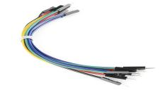
Hardware’s Required
Bread Board
A breadboard is a rectangular board with many mounting holes. They are used for creating electrical connections between electronic components and single board computers or microcontrollers﻿ such as Arduino and Raspberry Pi. The connections aren't permanent and they can be removed and placed again.
Jump Wires
A jump wire is an electrical wire, or group of them in a cable, with a connector or pin at each end which is normally used to interconnect the components of a breadboard or other prototype

Slide 24
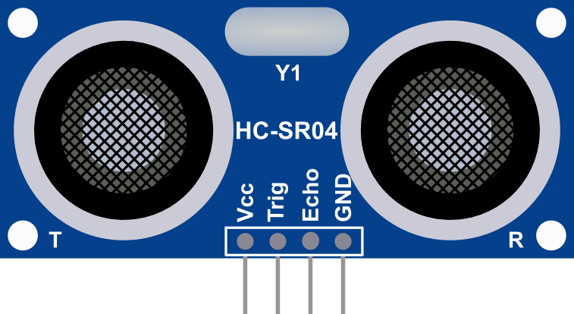
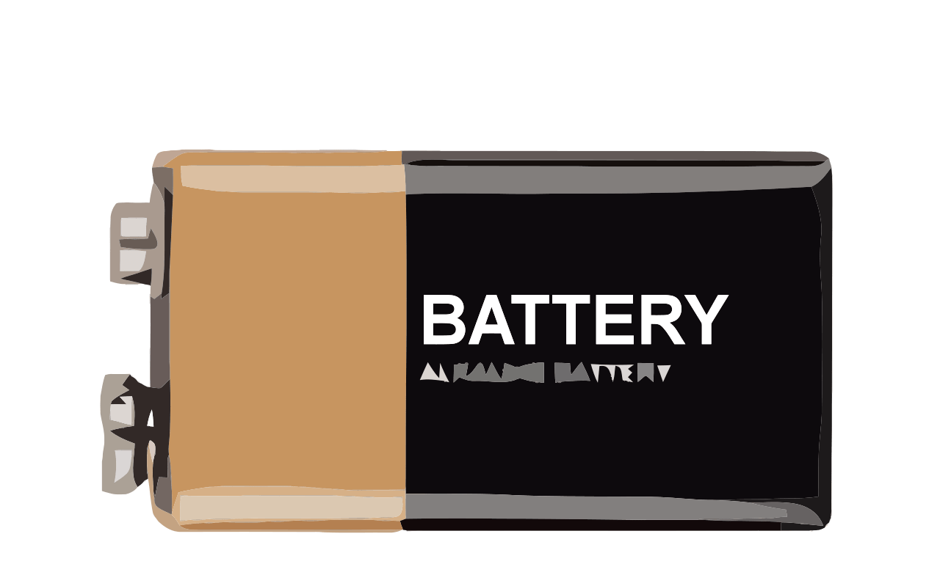
Hardware’s Required
Infrared Sensors
An infrared sensor is an electronic device that measures the distance of a target object by emitting infrared waves, and converts the reflected sound into an electrical signal.
Batteries
A battery is a device that stores chemical energy and converts it to electrical energy. The chemical reactions in a battery involve the flow of electrons from one material (electrode) to another, through an external circuit.

Slide 25

Hardware’s Required
Garbage Container
For collecting the garbage and make the setup
Laminated Cardboard
Laminated Cardboard to make the waste segregation arm.

Slide 26

Software’s Required
Arduino Software
The open-source Arduino Software (IDE) makes it easy to write code and upload it to the board. This software can be used with any Arduino board.
MERN Stack
For creating the application on which the whole data will be collected from Automatic Clean-out Corner

Slide 27
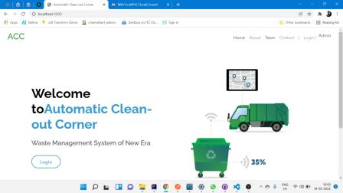
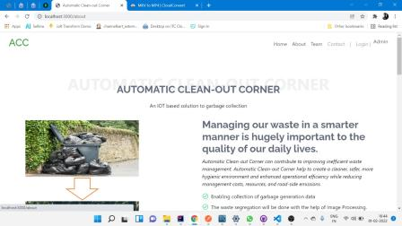
ACC Website
Home Page
About Us

Slide 28

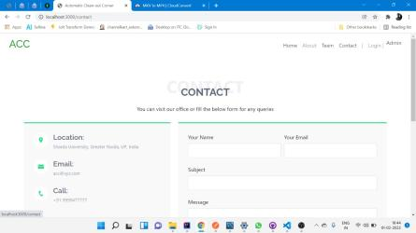
ACC Website
Our Team
Contact Us

Slide 29
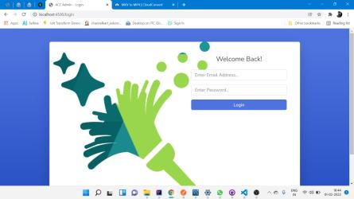
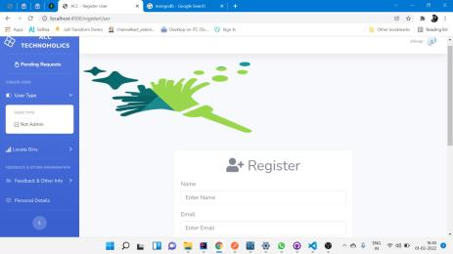
ACC Website
Admin Login
User (Non Admin) Login

Slide 30
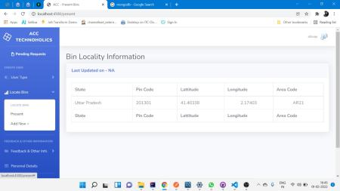
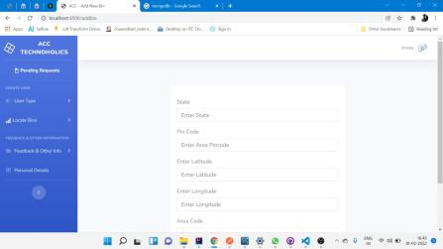
ACC Website
Bin Location Information
Add New Bin

Slide 31
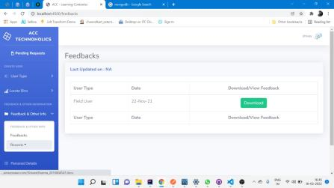
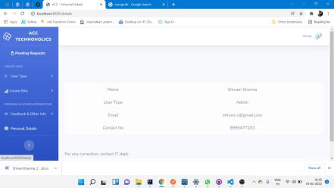
ACC Website
User Feedback
Personal Details of Admin

Slide 32
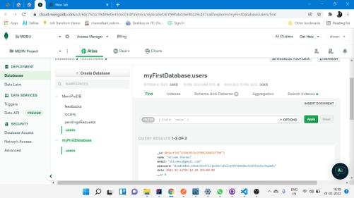
ACC Website
All the data are stored in the database

Slide 33
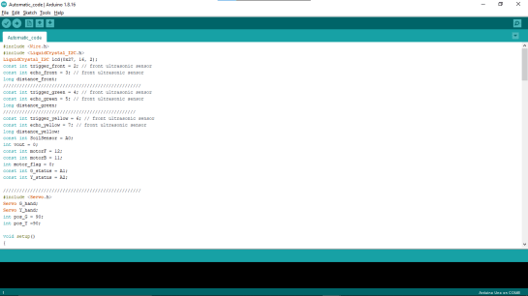
Arduino Codes
Code depicting automatic opening and closing of lid, capacity checking and segregation of waste

Slide 34
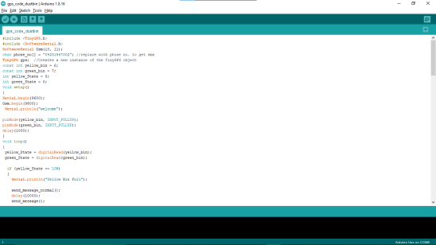
Arduino Codes
Code depicts GPRS tracking system by sending SMS and live location of dustbin to garbage collector for cleaning the filled dustbin

Slide 35
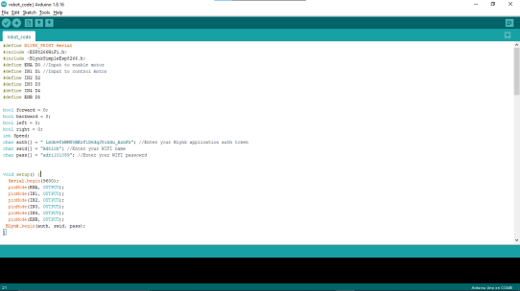
Arduino Codes
Code depicts the easy portability of dustbin by using BLYNK APP as a remote control

Slide 36

Blynk App Interface
This is the interface made using Blynk App for controlling the movement of the dustbin

Slide 37
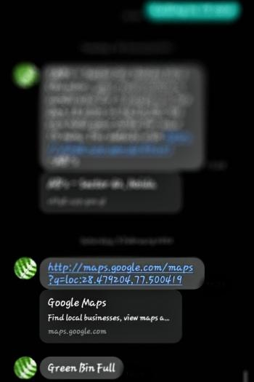
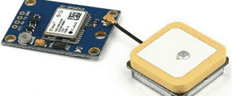
MESSAGING FUNCTION OF THE BIN

Slide 38
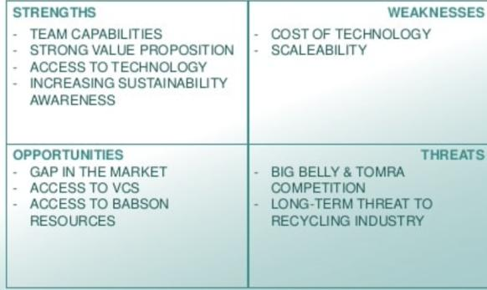
FEASIBILITY

Slide 39
Advantages of Automatic Clean-out Corner
A reduction in the number of waste collections needed by up to 80%, resulting in less manpower, emissions, fuel use and traffic congestion.
A reduction in the number of waste bins needed
Analytics data to manage collection routes and the placement of bins more effectively
Improved environment (i.e. no overflowing bins and less unpleasant odours)

Slide 40
Advantages of Automatic Clean-out Corner
Automatic Clean-out Corner will be environmentally friendly. By reducing the need for collection visits, it will lower emissions of carbon dioxide and other gases. As a result, we’re getting cleaner and safer streets. A reduction in the number of waste bins needed
Using a gentle compaction system maximises bin capacity, allowing you to keep more waste in the bin.
Smart Bins help to create a cleaner, safer, more hygienic environment and enhanced operational efficiency while reducing management costs, resources, and road-side emissions.

Slide 41
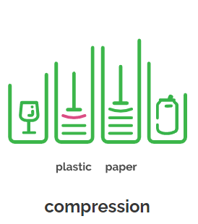
FUTURE SCOPE
Waste Compression
The When the waste inside a bin reaches a pre-set level, the trash compactor will be activated to compress the waste allowing the bin to hold up to eight times more waste and reduce the collection frequency by up to 80%. This is a huge boon for managing bins in remote areas like large parks or beachside areas and campsites.

Slide 42
REFERENCES
[1] Xu Chand and Wukey, 2015. https://ieeexplore.ieee.org/abstract/document/8591236
[2] J. D. Bellamy et al., Computer Telephony Integration, New York: Wiley, 2015.
[3] Ana Pires, Sustainable solid waste collection and management, 2018, pp. 175–225.
[4] N. B. Vargafik, J. A. Wiebelt, and J. F. Malloy, "Radiative transfer," in Convective Heat. Melbourne: Engineering Education Australia, 2019, ch. 9, pp. 379–398.
[5] H. C. Hottel and R. Siegel, "Film condensation," in Handbook of Heat Transfer, 2nd ed. W. C. McAdams, Ed. New York: McGraw-Hill, 2020, ch. 9, pp. 78–99
[6] Victor Bonn, Waste Management a Modern Approach. , 2020, ch. 9, pp.40-60.
[7] H. Schmidt-Walter and R. Kories, Electrical Engineering. A Pocket Reference. Boston: Artech House, 2007. Accessed on: Oct. 16, 2016. [Online]. Available: http://ebrary.com
[8] H. H. Gaynor, Leading and Managing Engineering and Technology, Book 2: Developing Managers and Leaders. IEEE-USA, 2011. Accessed on: Oct. 15, 2016. [Online]. Available: https://www.ijert.org/research/smart-trash-collecting-and-segregating-robot-IJERTV9IS110152.pdf
[9] G. H. Gaynor, "Dealing with the manager leader dichotomy," in Leading and Managing Engineering and Technology, Book 2, Developing Leaders and Mangers. IEEE-USA, 2021, pp. 27–28. Accessed on: Mar. 16, 2021. [Online].
[10] Kellow Pardini and Vasco Furtado . IEEE-INDIA, 2020. Accessed on: Feb 6, 2021. [Online]. https://ieeexplore.ieee.org/abstract/document/8690984

Slide 43
Thank You!
ACC
IOT BASED SMART BIN

